Slide 1





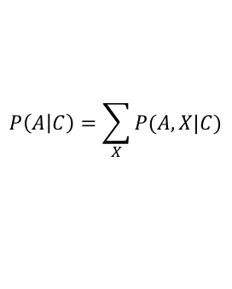




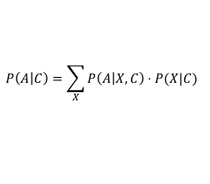



Probability cheatsheet
Gavin Band, GMS 2020
1. Probability expresses uncertainty:
$$P\left(X | C\right)=0$$
=> “X definitely not true”
$$P\left(X | C\right)=1$$
=> “X definitely true”
Extends standard logic
$$0<P\left(X | C\right)<1$$
=> we are uncertain about X
2. All probability is conditional:
$$P(X)$$
always means
$$P(X|C)$$
“probability of X”
“probability of X given C”
where C represents background information (i.e. a model).
C is often dropped from notation but is always there.
e.g. P( | die is fair) = 1/6
P( transmission | infection rates)
etc.
Model of die
Model of infection
3. Probability is computable:
I.
$$P\left(!A | C\right)=1−P(A|C)$$
(A either occurs or doesn’t.)
“not A”
II.
$$P\left(A \text{or} B | C\right)$$
$$=P\left(A | C\right)+P\left(B | C\right)−P(A,B|C)$$
(One of them must occur,
but don’t double-count)
“A and B given C”
III.
$$P\left(A,B | C\right)$$
$$=P\left(A | B,C\right)⋅P(B|C)$$
(Split up joint probabilities into conditional ones.)
“A and B given C”
“A given B and C”
“B given C”
NB. “independence” happens when the middle term simplifies: P(A|B,C)=P(A|C)
4. These generate practically useful tools for computation:
$$P\left(A | C\right)=\sum_{X}{P(A,X|C)}$$
Computes a probability by summing (or integrating) over all the possible values of another variable.
Often seen as:
$$P\left(A | C\right)=\sum_{X}{P\left(A | X,C\right)⋅P(X|C) }$$
by applying rule III
Bayes’ rule:
$$P\left(A | B,C\right)$$
$$=\frac{P\left(B | A,C\right)⋅P(A|C)}{P(B|C)}$$
Computes P(A given B)
in terms of P(B given A)

